Slide 1
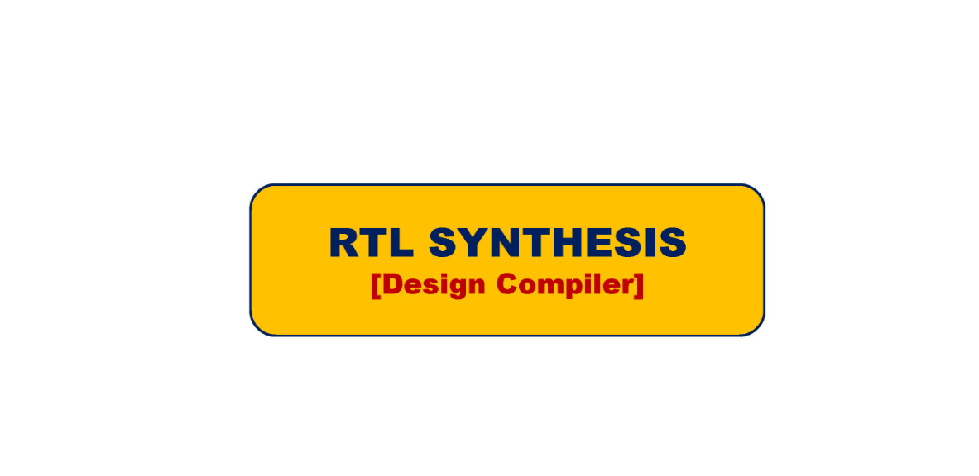

Slide 2
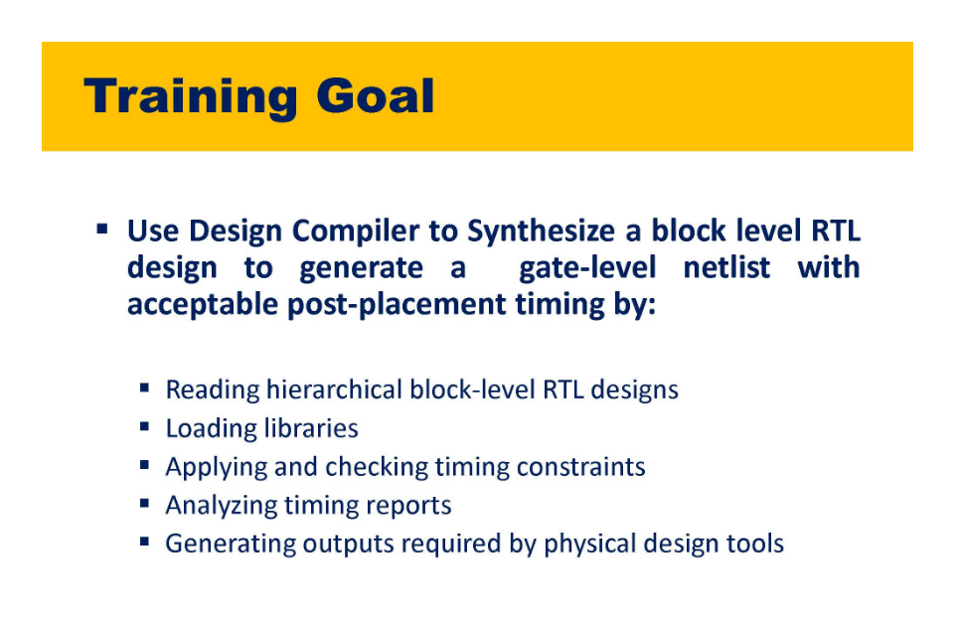

Slide 3
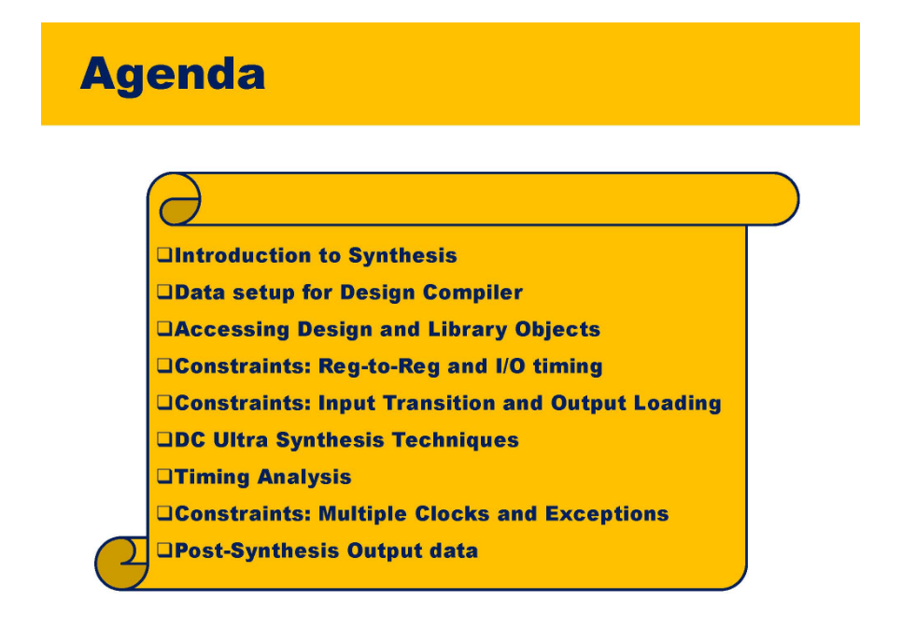

Slide 4
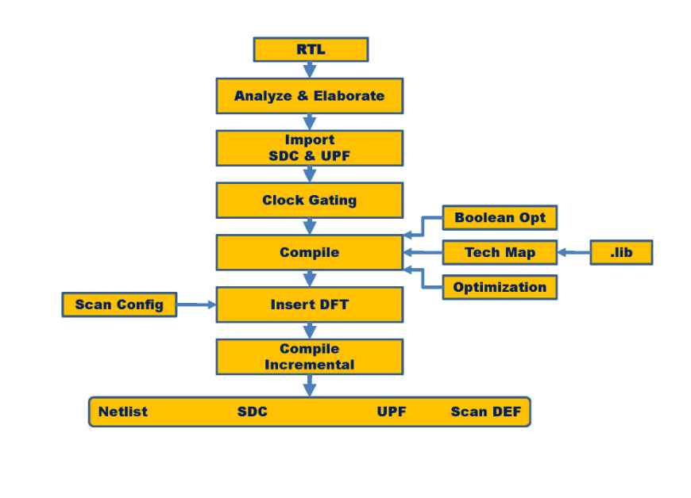

Slide 5
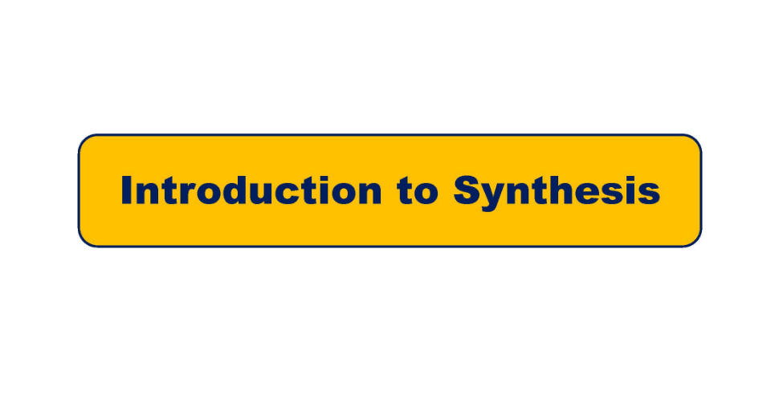

Slide 6
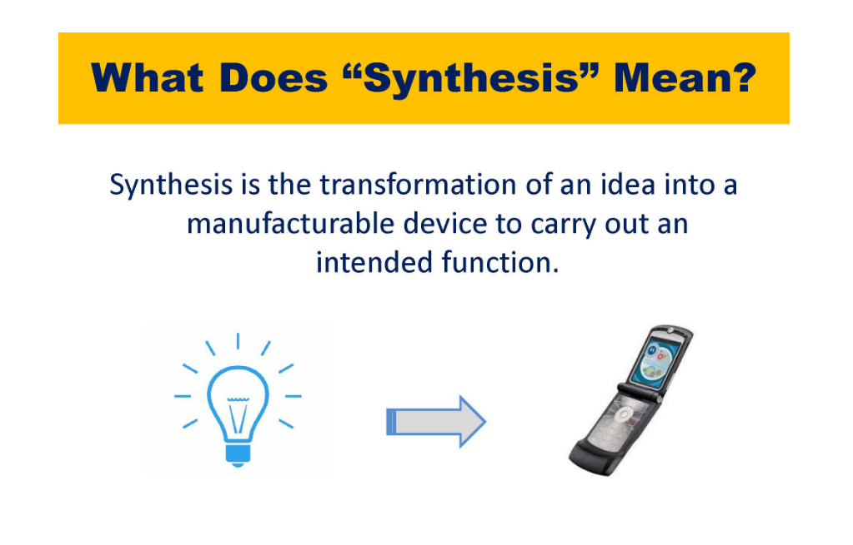

Slide 7
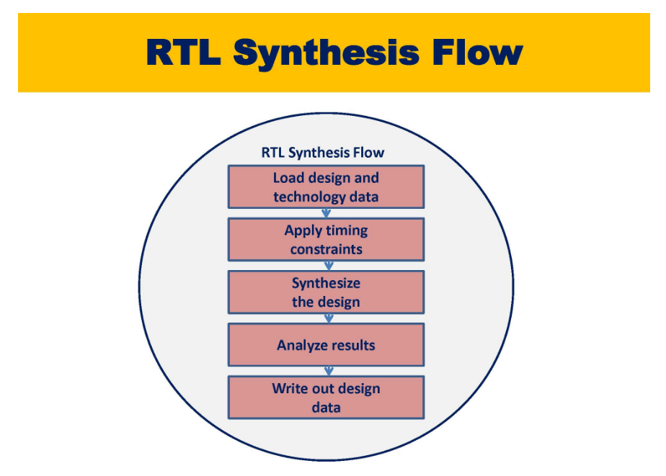

Slide 8
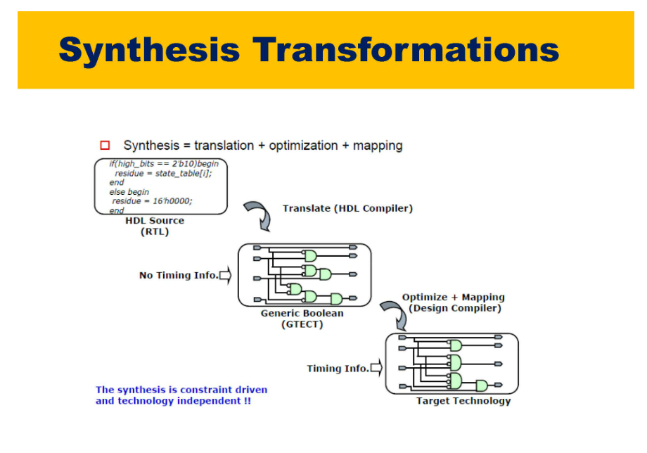

Slide 9
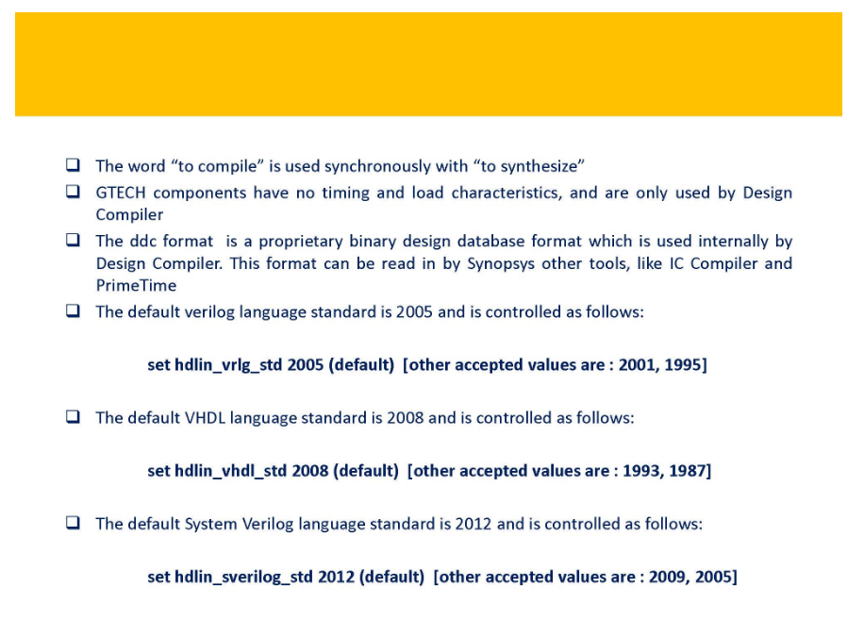

Slide 10
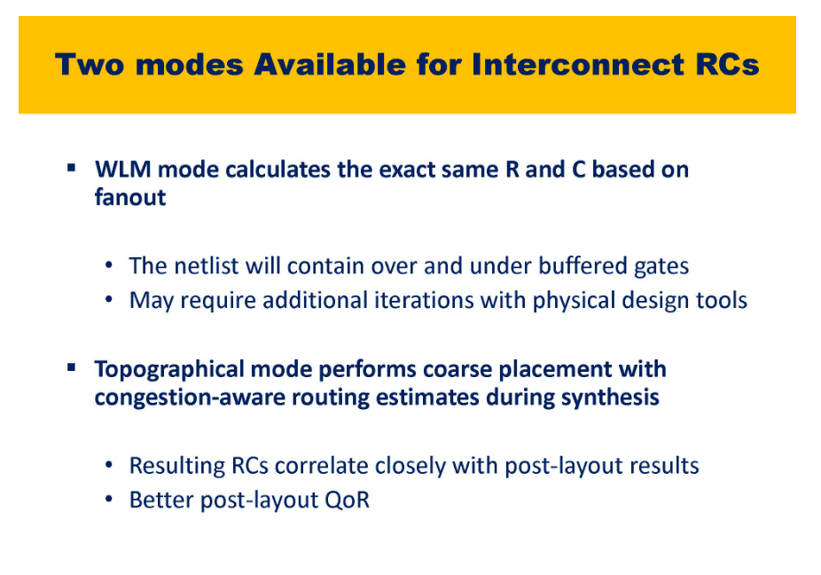
Wire Load Model – Takes the fixed R and C based on fanout

Slide 11
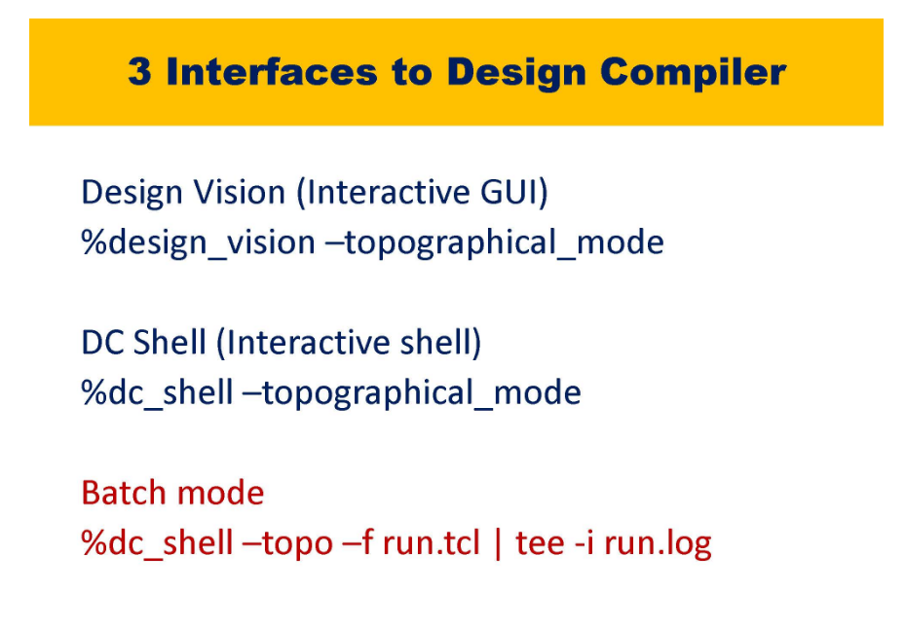
For the shell mode the commands specific to the tool needs to be stored in a script and script needs to be run for the batch mode, the tool specific command can be run from terminal directly moreover we do not wait for the script to be completed and can do other work on the side
Tee is terminal command, the results of run.tcl will get stored in run.log

Slide 12
Default file runs in DC Expert mode and for topological mode you have to write dc_shell -t

Slide 13
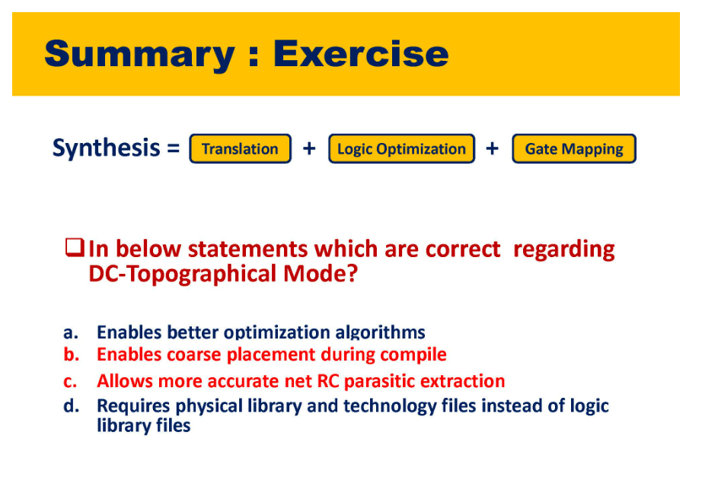

Slide 14
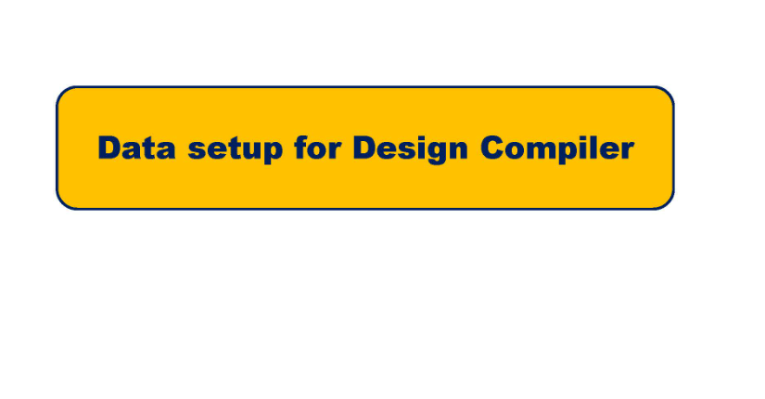

Slide 15
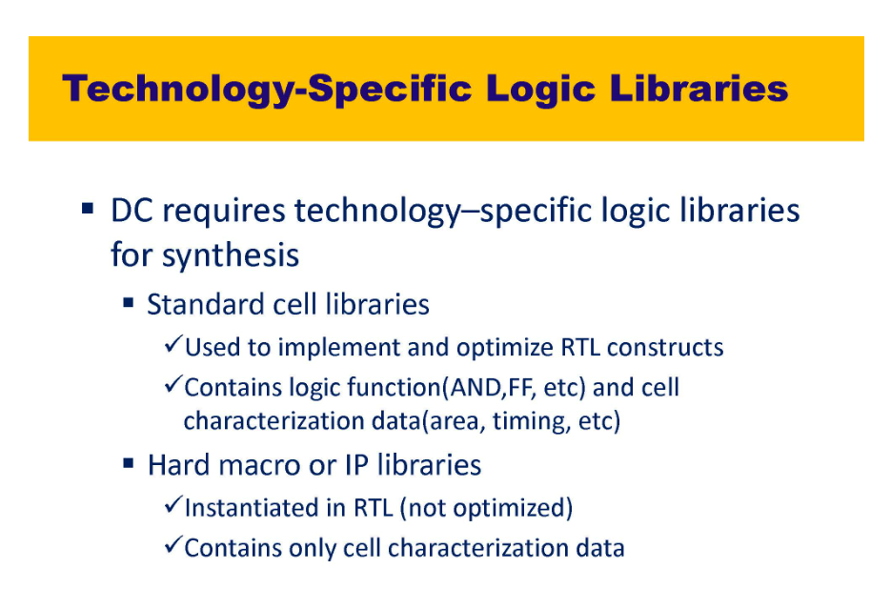
3rd party libraries like memory. These are IP’s from the IP Libraries which are instantiated in the design. These are NOT RTL. For these cells instead of RTL files we provide .lib files
DC compiler only understands .db file (data-base file), These are in binary formats which is not readable to read anything you have to open the equivalent .lib files.
Library compile reads .lib and writes out .db files. DC_compiler understands .db files only.
LEC understands .lib files only
.lib contains standard cells which has all the functionality as well as timing information

Slide 16
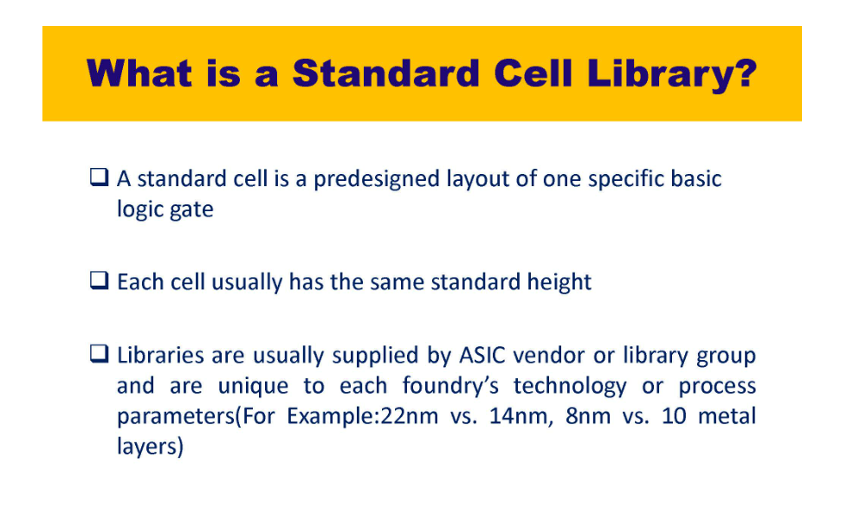
Companies which manufacture the chips gives standard cell libraries to design team. Some manufactures are Intel, TSMC
Gate level netlist should not have GTECH cells otherwise it will not have timing information and thus will not map to gate level netlist and hence will not synthesize properly

Slide 17
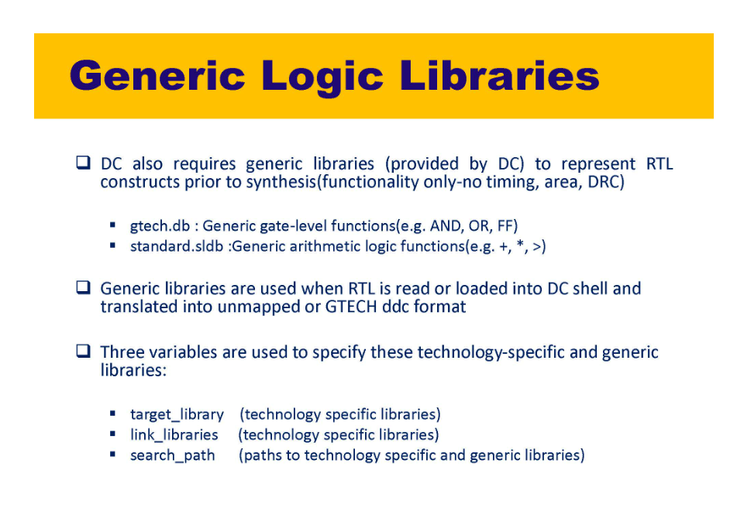
Generic libraries are provided by EDA vendors like synopsys but standard cell libraries by Intel, TSMC manufacturers

Slide 18
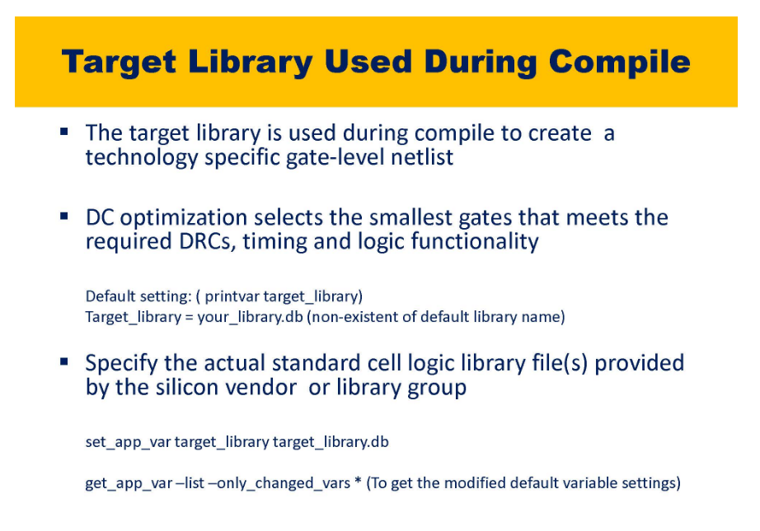

Slide 19
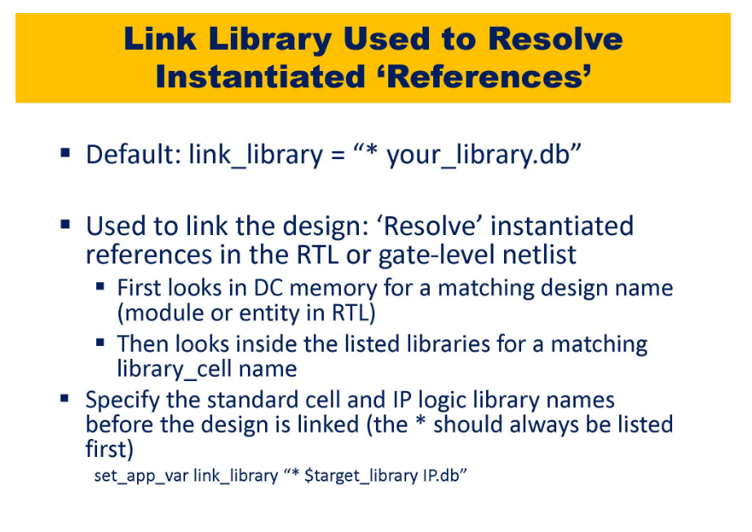

Slide 20
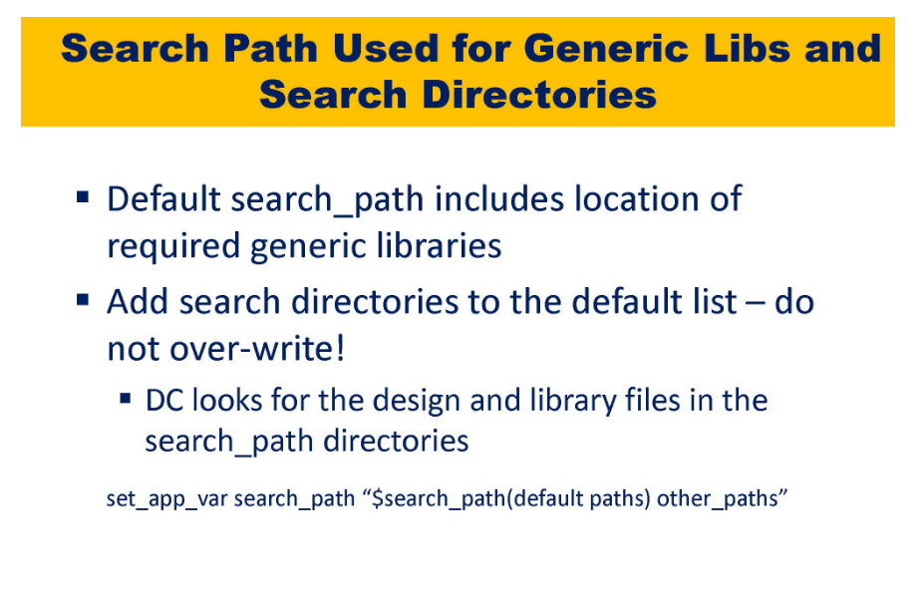

Slide 21
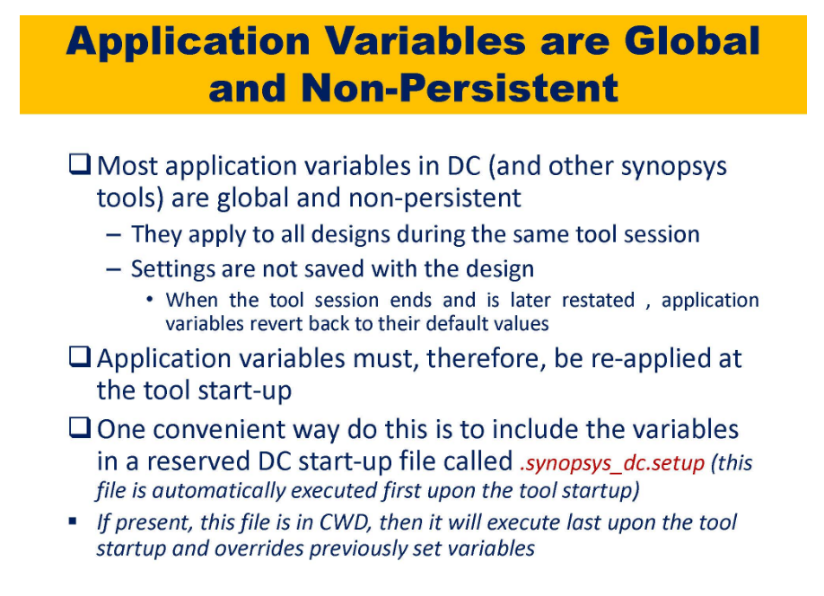

Slide 22
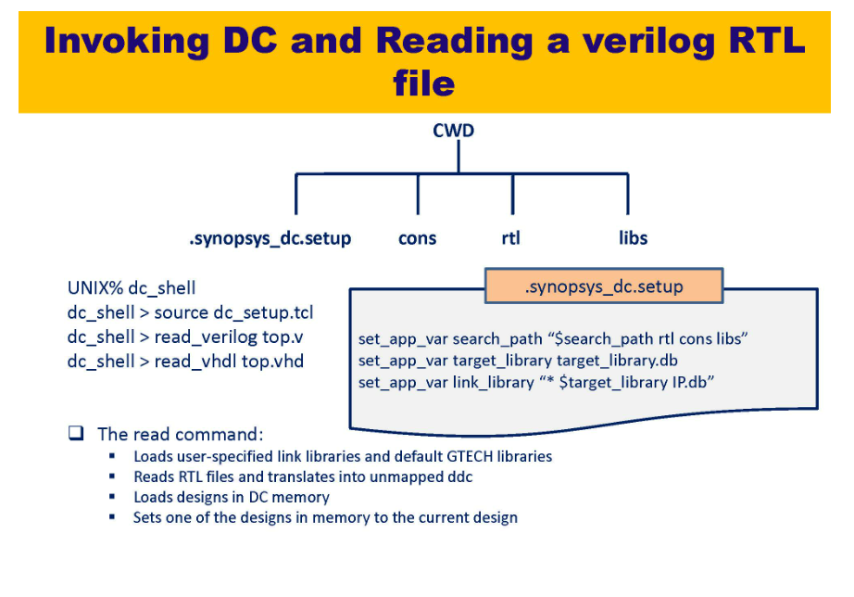

Slide 23
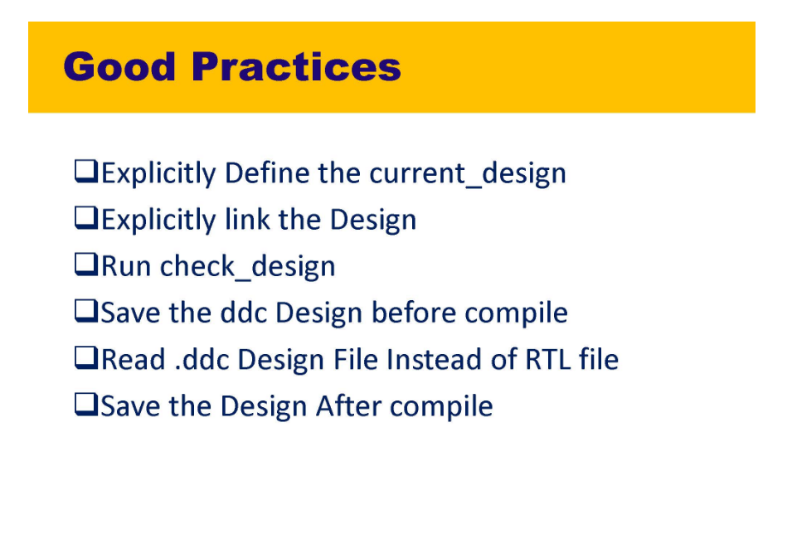

Slide 24
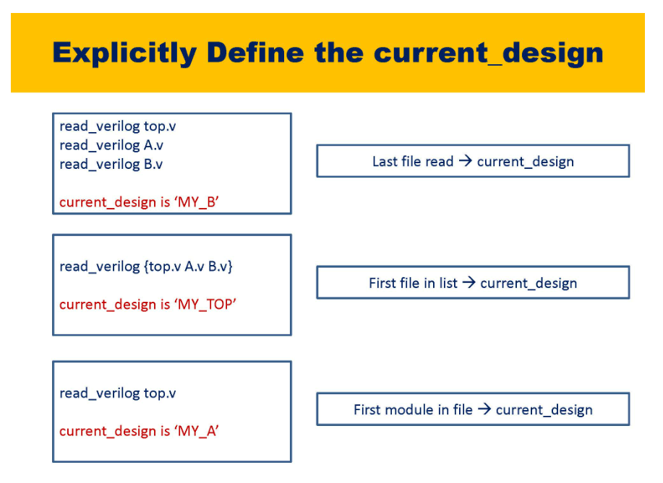

Slide 25
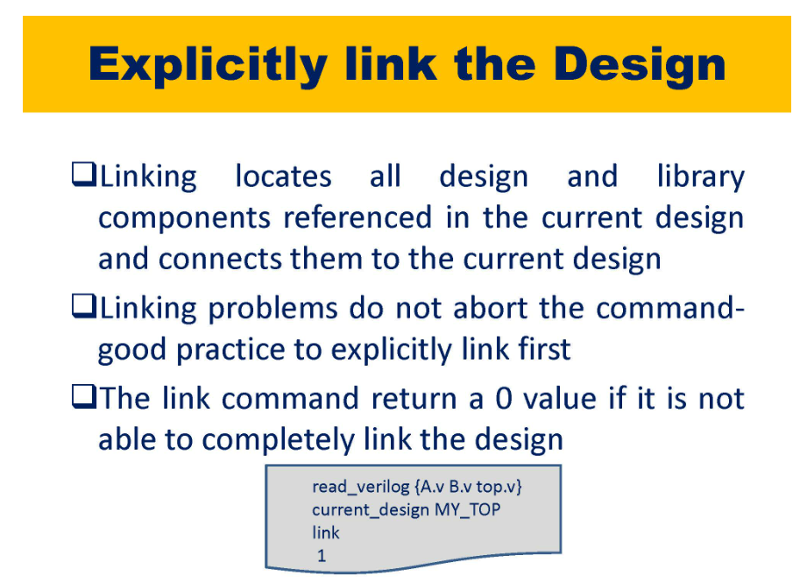

Slide 26
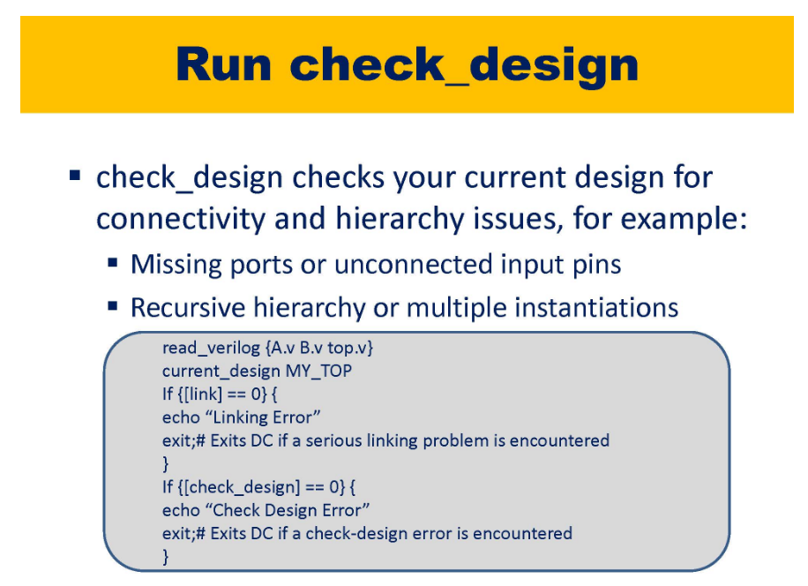

Slide 27
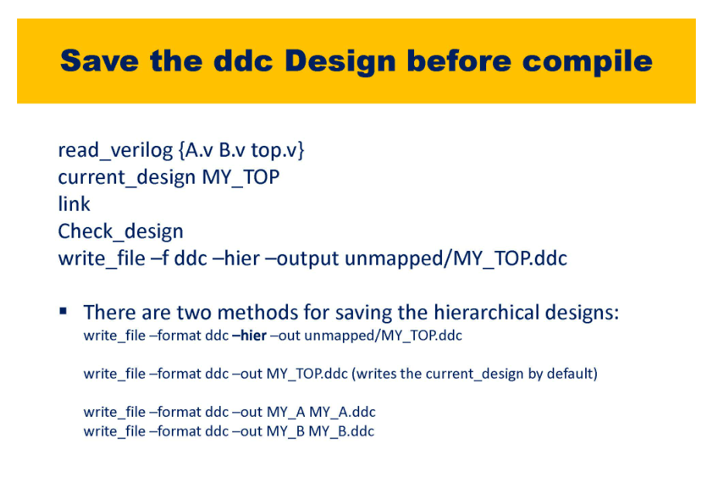
Unmapped is the directory name which will contain unmapped(elaborated) GTECH cells

Slide 28
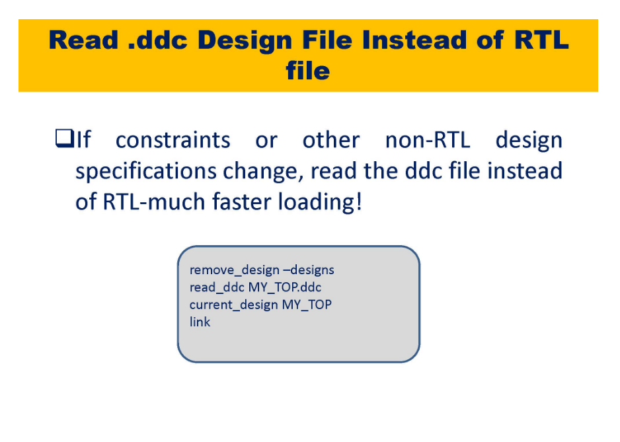
Remove the loaded designs first and then read .ddc

Slide 29
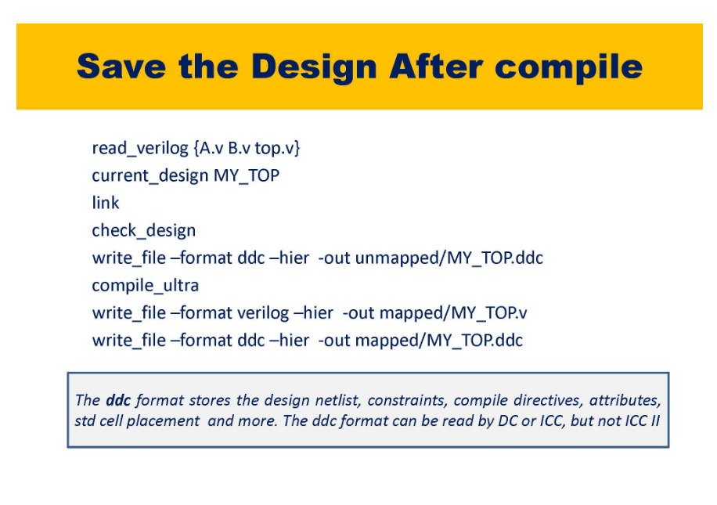

Slide 30
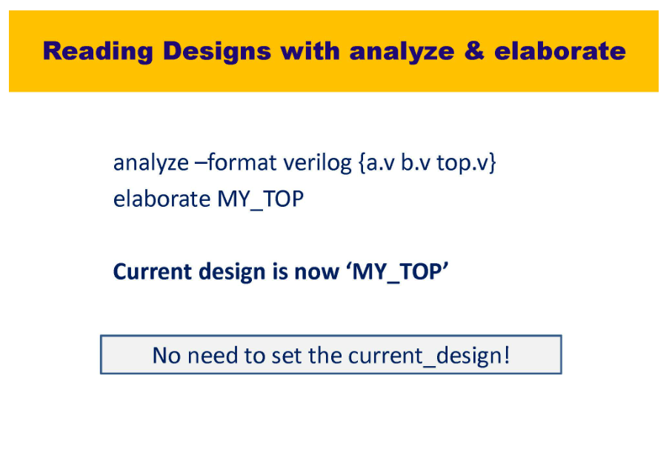
This has the advantage that current design is now MY_TOP

Slide 31
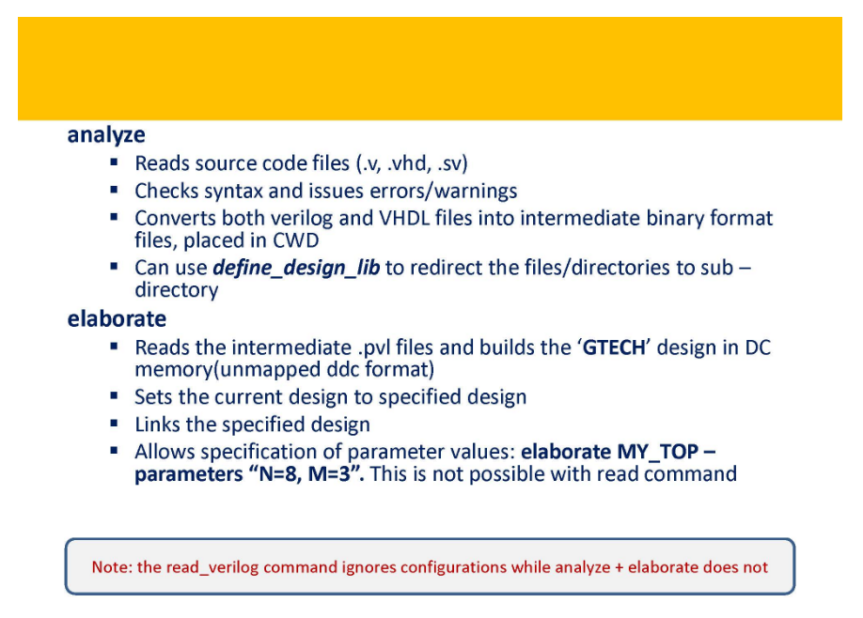
.pvl are intermediate files only understood by DC Compiler

Slide 32
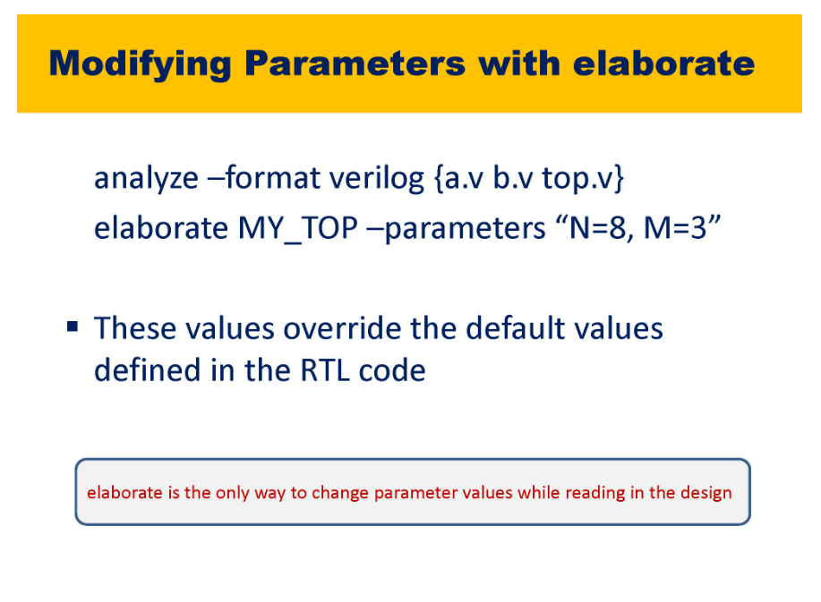

Slide 33
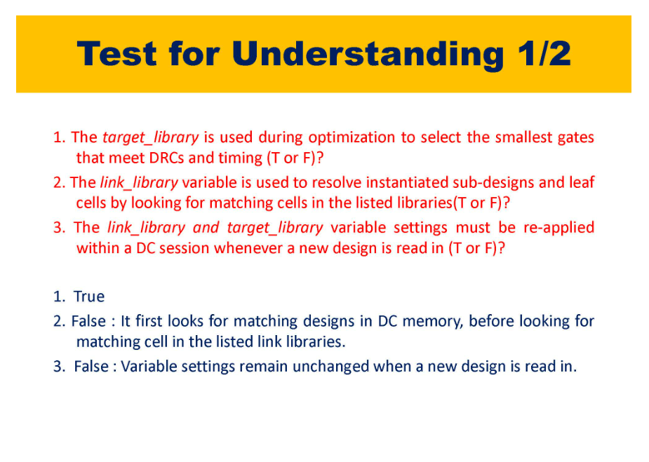

Slide 34
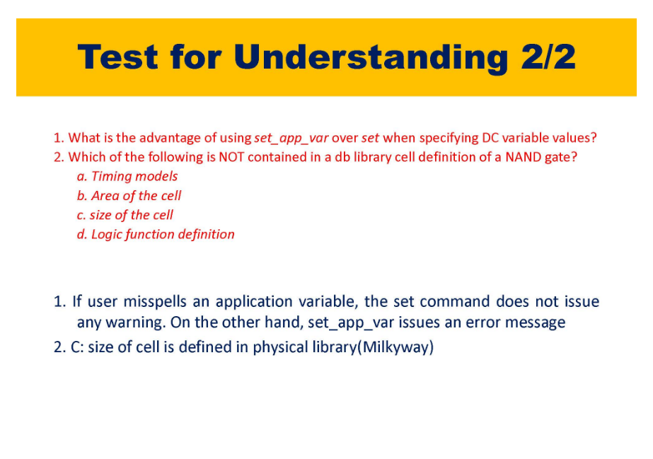

Slide 35
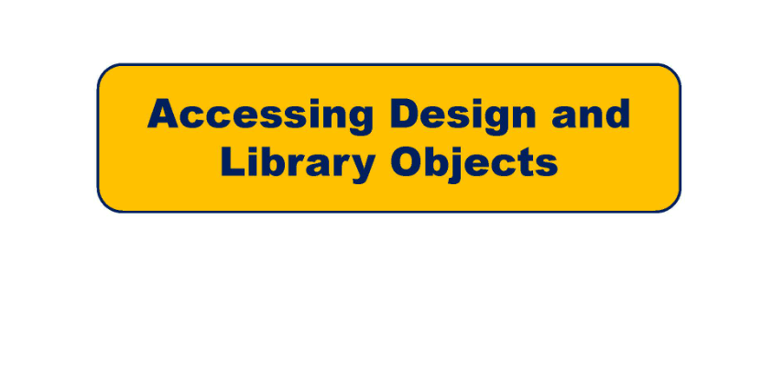

Slide 36
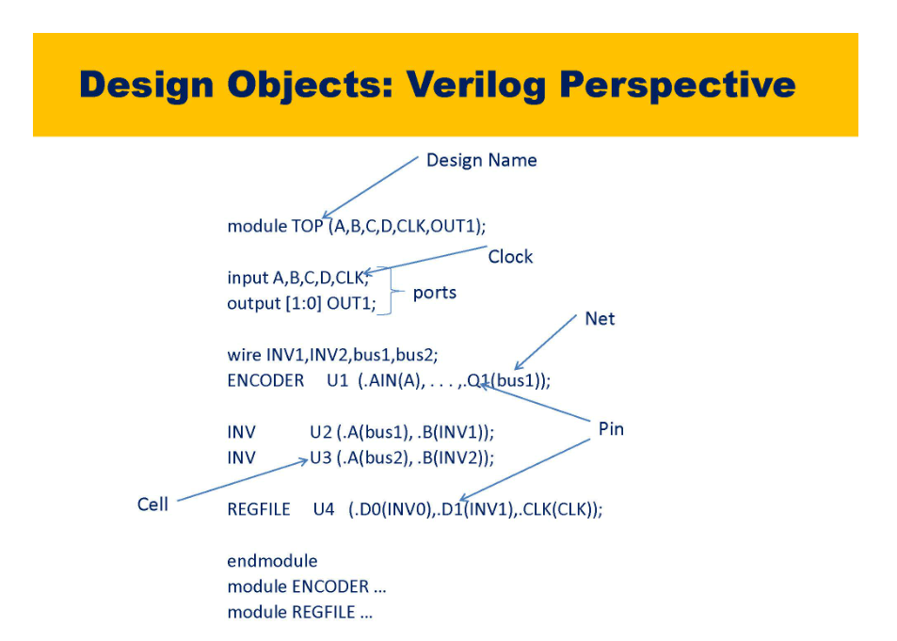

Slide 37
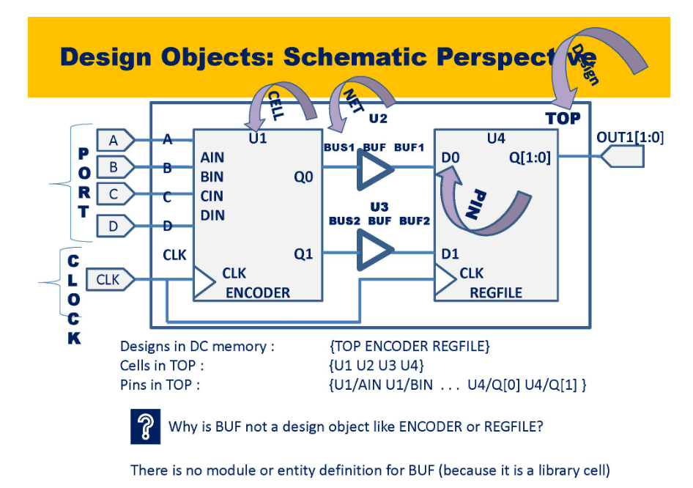

Slide 38
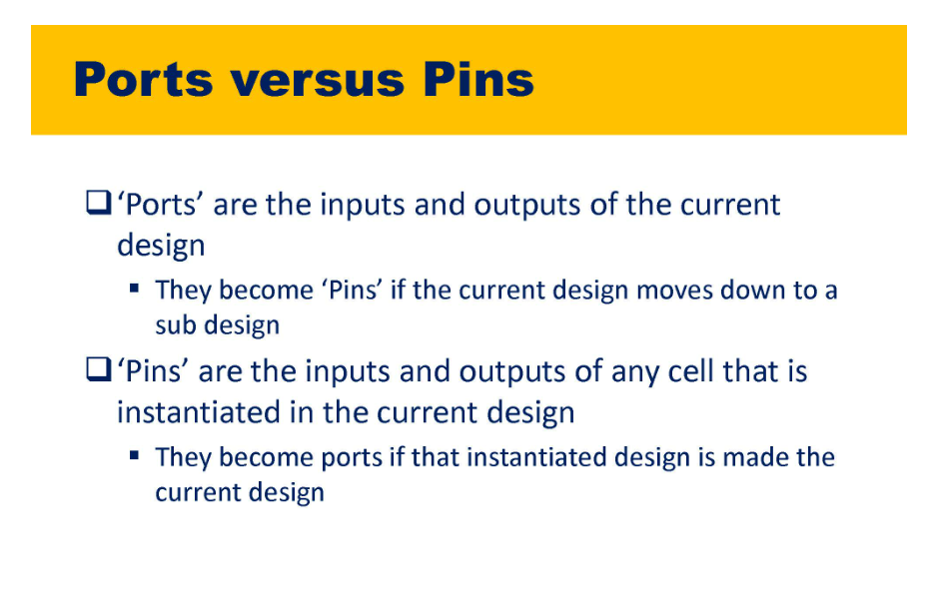

Slide 39
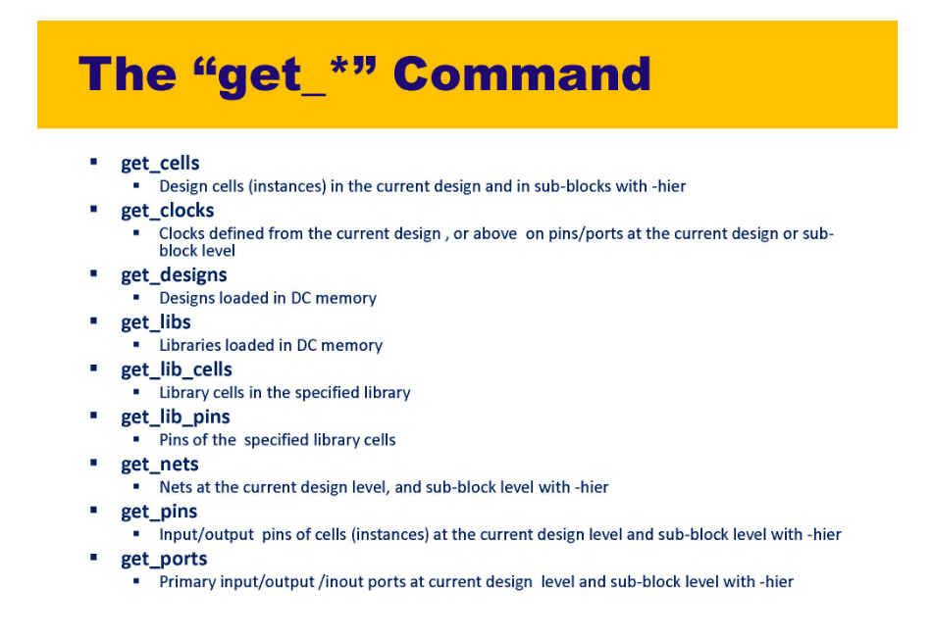

Slide 40
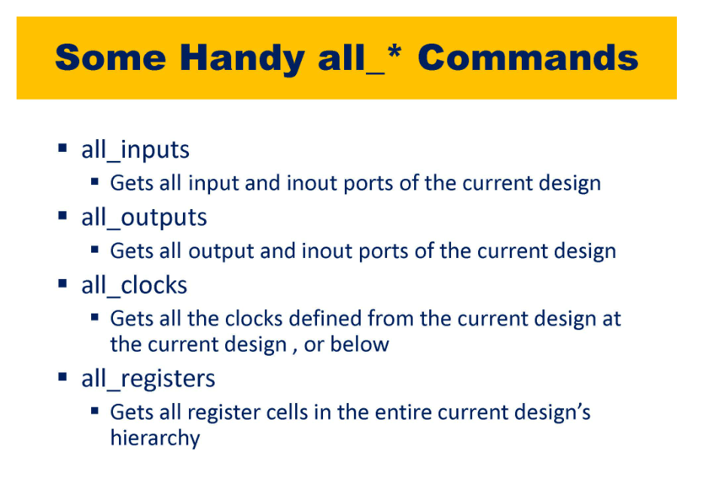

Slide 41
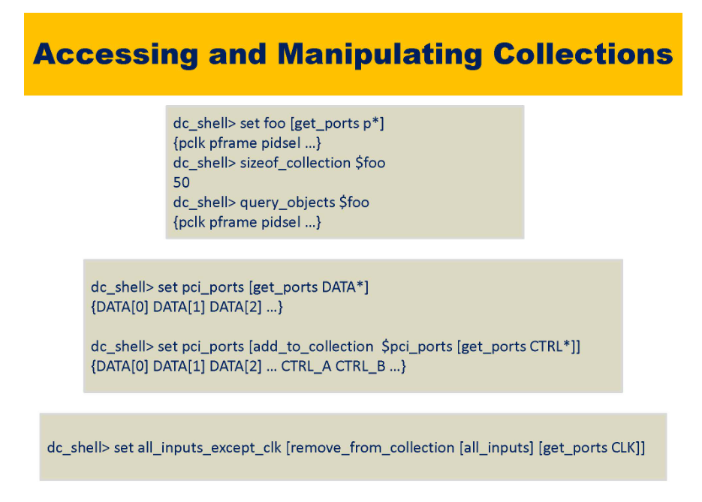

Slide 42
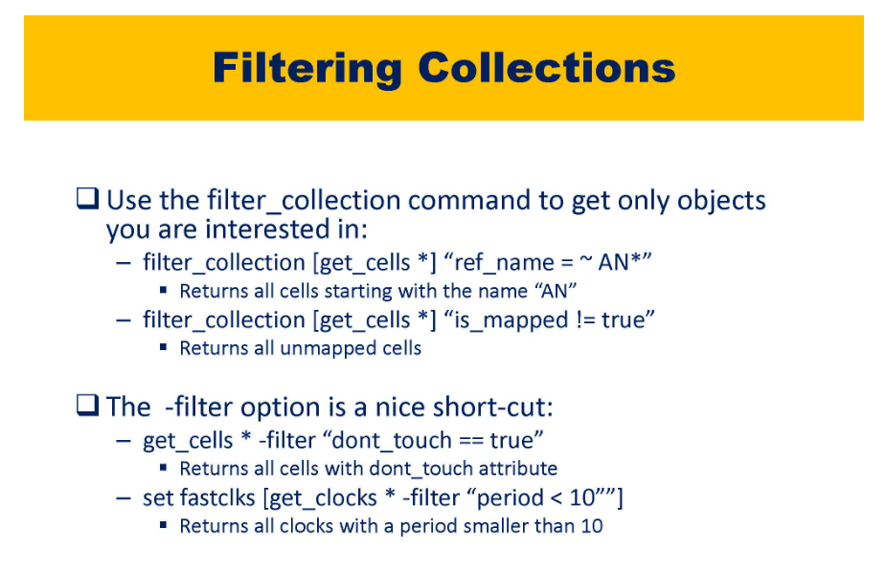

Slide 43
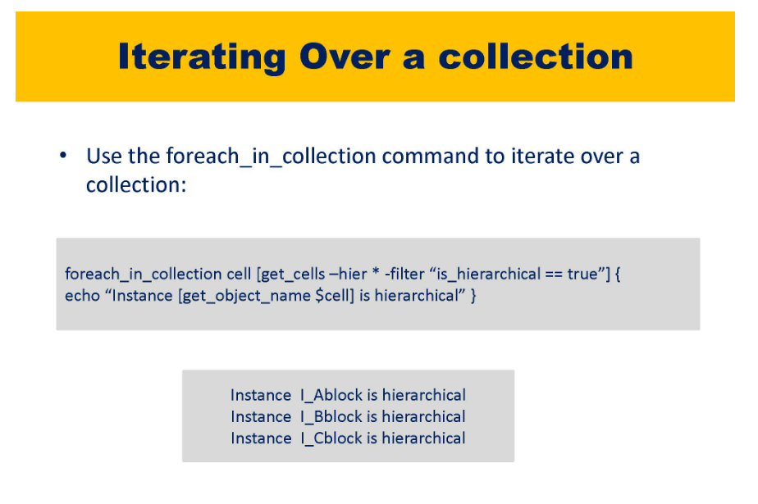

Slide 44
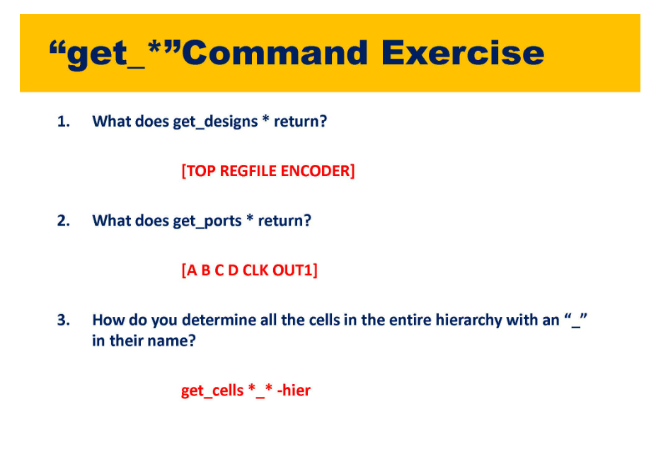

Slide 45
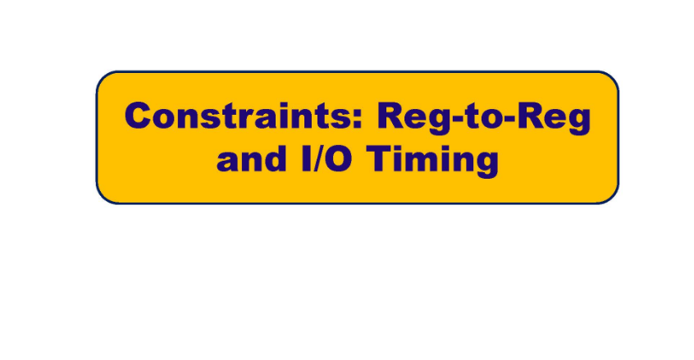

Slide 46
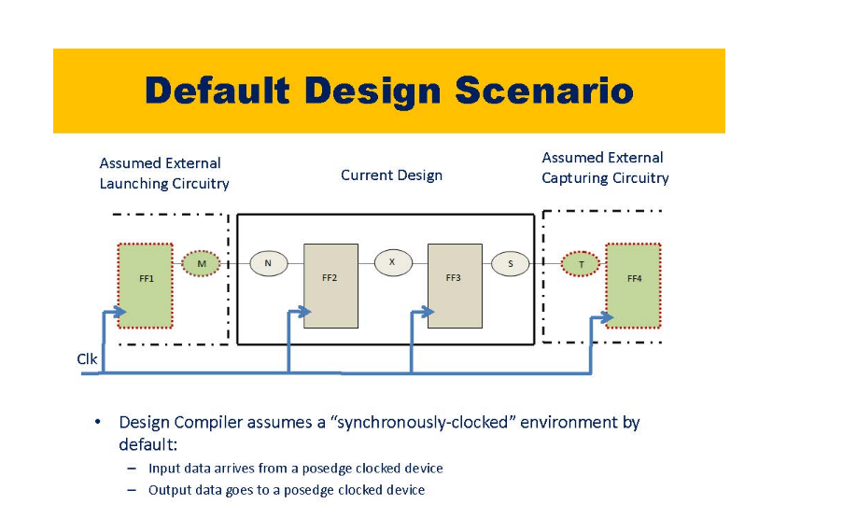

Slide 47
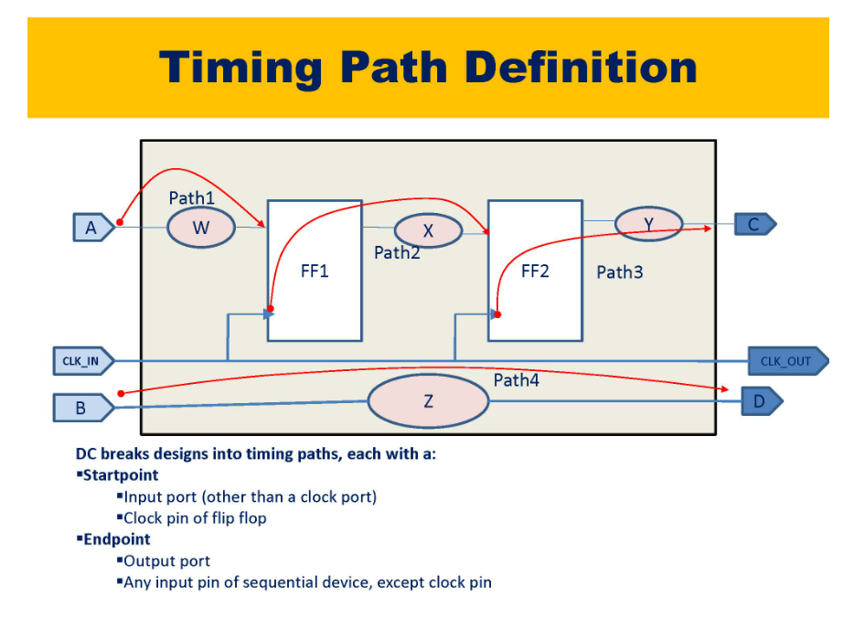
Virtual clocks are used for testing frequency at which the circuit will run
Once all clocks are defined, all register to register paths are constrained. So there will be 4 paths in our design
1. Input to Reg
2. Reg to Output
3. Reg to Reg
4. Input to Output

Slide 48
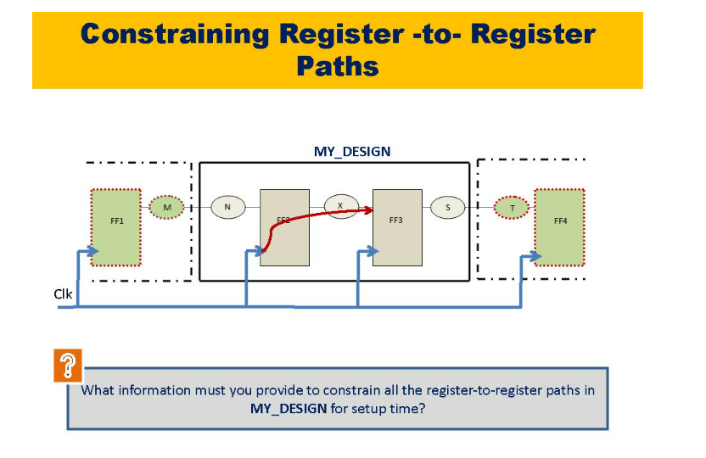

Slide 49
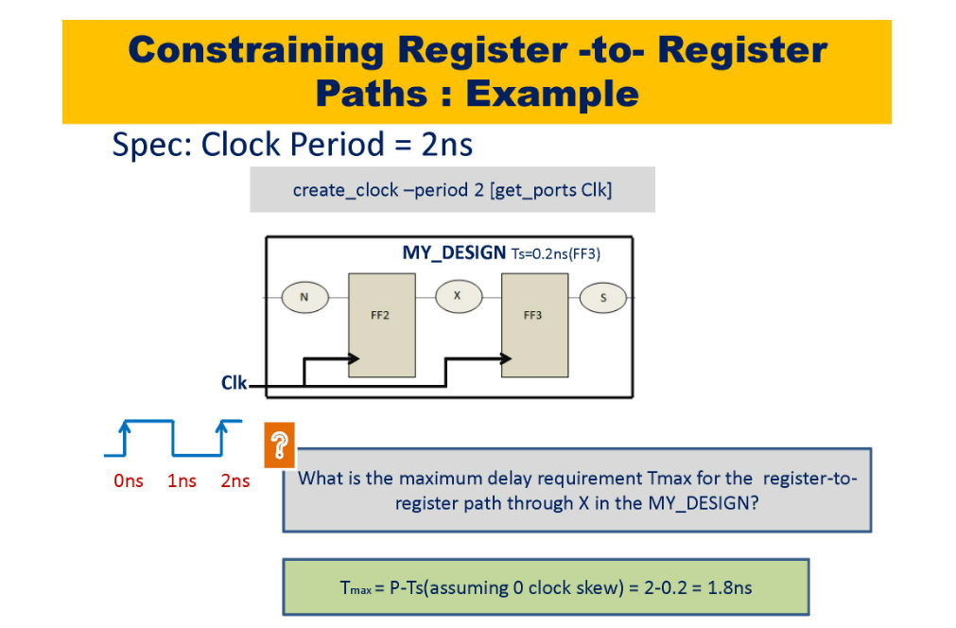

Slide 50
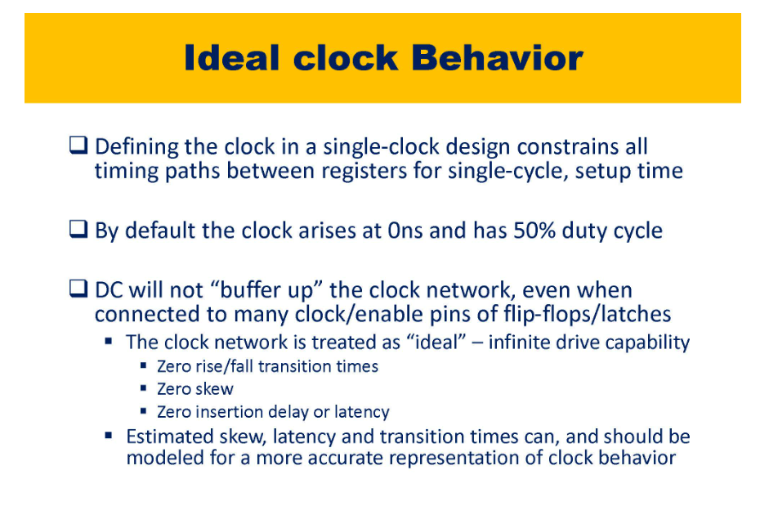

Slide 51
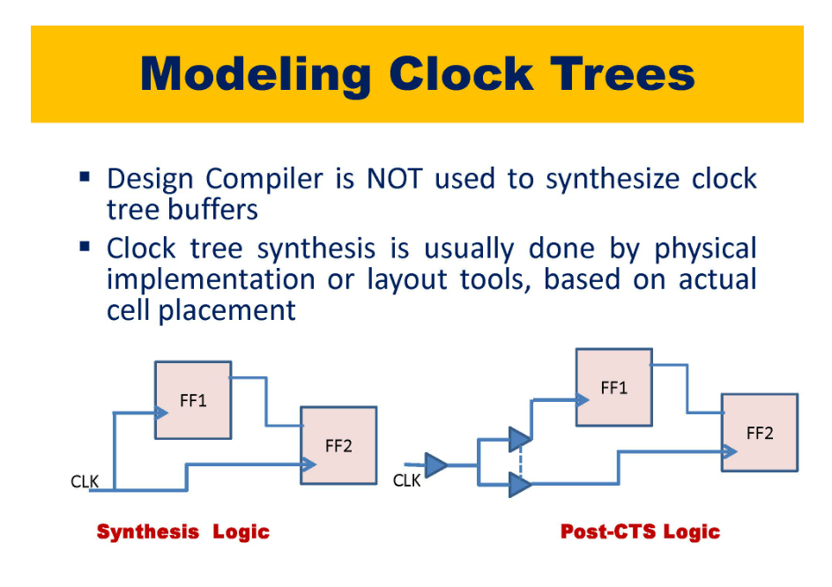

Slide 52


Slide 53

Latencies are of two types - Source latency and Network latency.
Source Latency - From source PLL to where the clock is defined (port of the design)
Network Latency - From Port(clock definition) to Register Pin
There is no network latency in Post-CTS clock constraints because we will keep buffers inside and take accurate values and also we
will remove ideal networks from the clock because we have to take exact values for that we will add set_propagated_clock[get_ports clk],
when you give this it will ignore all the ideal clocks
Algorithms like H-Tree and Star-Tree are used to balance the clock during CTS

Slide 54


Slide 55


Slide 56

P = 0.6(c2q)+0.2(Tsu)+Tax(prop_delay)+Tjitter&margin
Tax(prop_delay) = P - Tc2q(this includes here c2q+tM, named as input delay) - Tuncertainity(jitter + margin) – Tsu = 2 - 0.6-0.3-0.2 = 0.9
Hence DC will optimize the "N" comb logic such that Tmax is less then 0.9. If DC is not able to optimize circuit
it will throw setup or hold violations

Slide 57


Slide 58


Slide 59

Let's assume we don't know clock relations like inputs and outputs still you can create a VIRTUAL clock.
Meaning actual clock frequency is not known. But using virtual clock you can see if violation happens in combinational ckt
you can play with VIRTUAL clock frequency
create_clock -period 2 -name VCLK (not that there is no get_ports clk) over here, because this clock is not
existing in the design but later when we are integrating the design at that time we can add the actual clock
In Initial stage we do not know the exact values, interface levels, w.r.t to what clock(100MHz, 500MHz, etc), design needs to be integrated,
Irrespective of the initial values we can design the system with time budgeting which means 60% for outside and 40% time for inside delay
so 6ns for input and output delays and 4ns for DC for internal system delays, and dc will optimize design for 4ns
If you don't know the input and output clock while designing a subsystem then we have to go with virtual clock assuming
the same virtual clock on both input and output. Now we can apply input and output delay w.r.t virtual clock

Slide 60

Time Budgeting - We keep 40% time budget for inputs and outputs when we do not know input delays and setup requirements of outputs
Notice that clocks are not included for Time budgeting

Slide 61


Slide 62

If compile_ultra is zero it means that optimize timing, power and DRC to max and keep area as lowest priority
report_area - area is reported in terms of gates count after compile - 100 million gates

Slide 63

Till now we have constrained clk, inputs and outputs but clk/inputs/outputs have Constraints like Input Transition and Output Loading then
only it will provide accurate netlist and timing report, if not mentioned it will consider default needed values (might consider
less output load and fail DRC)

Slide 64

Factor Affecting Timing - Based on which circuit is driving inputs, Input transition will happen same goes with output load capacitance

Slide 65

Increase the drive strength of input AND gate to make faster transition and reduce output loading

Slide 66


Slide 67

set_input_transition -max is for setup analysis -min is for hold analysis

Slide 68

Modelling Input Transition - set_driving_cell -max -lib_cell FD1 -pin Qn[get_ports A] Qn of FF is driving input port A

Slide 69


Slide 70

Load Budgeting - Always assume weak input driver and max output load

Slide 71


Slide 72


Slide 73

DC will optimize tge operation A + 2*B - 2 + B - A + 7 to 3*B + 5 and use only one multiplier and one adder in the design

Slide 75

Libraries have both normal flops and scanable flops
compile_ultra -scan will generate scan flops with test inputs connected to gnd
after that DFT team will provide scan configuration which has Scan chain lengths, scannable flops, non-scannable flops
when you do compile_ultra-incremental -scan DC will start from stitching only w.r.t TI and TE that is it won't do optimization
again, it will stich and then later it will optimize entire design with scan logic ang give optimize netlist
DFT compiler tool inside design compiler will stitch the scan logic based on DFT configuration file (which has scannable and non-scannable clks
information in the design)

Slide 76
Test-Ready Synthesis - Stitiching the test logic
When you do incemental compile If scan cells are ready it will stitch if not it cannot stitch. To make sure
that it has scan cells when you use compile_ultra command we have to use -scan
When you provide compile_ultra -scan so it will convert normal flops to scanable flops with Mux having mux_input and mux_enable to gnd
when later it is stitched it will be connected to test_input and test_enable when you write compile_ultra-incremental -scan
if we give -incremental compile it will stitch and then compile, if you are not writing -incemental then it will again start optimization
-incremental will stitch optimized design and after stitiching it will optimize the complete design and update the timing and
throw updated reports.

Slide 77

High - Effort Timing Optimization
low_effort means low QoR(results) hence timings will violate etc but will take less time
high_effort will optimize more (less timing, less area) but will take more time. default is low_effort

Slide 78

Creating user-defined path groups
DC will spend some time optimizing a particular path groups if we want to
3 groups are mentioned here DC will automatically 4 groups that is reg-reg
Now DC will try to optimize each group separately If we do not write groups it will treat the design same by default. before
synthesizing the design itself we can write these 4 path gorup
but After synthesizing and compiling you get the netlist. Now lets say while analzing the report you know that 50 critical paths are
not meeting timing requirements hence now you can create your own path groups of these 50 paths and DC will try to optimize those
paths more and will achieve the time

Slide 79


Slide 80

Timing reports also breaks down the paths in to 4 groups discussed before
Note that DC is not a timing sign-off tool
If groups are not provided each clocked paths will be considered as one clock
By default only setup violations will be reported

Slide 81


Slide 82


Slide 83


Slide 84

Clocks derived - are clocks from clock gating, clock multiplier, clock divider
Mutually exclusive sync clocks - two clocks reaching mux but mux output can only be one
Asynchronous clocks needs to be ignored as it will be taken care in CDC
Multi-cycle clocks gives output in multiple cycles
Synchronous clocks means the edge of the clocks align after some period

Slide 85


Slide 86


Slide 87

Clock propagation through sequential clock - by default, DC won't propagate clk through clock gating, clock multiplier, clock divider (generated clocks)
these should be defined as create_generated_clocks
we have to tell DC explicitly to create generated clocks
Always apply generated clocks on Pin Q as the net above it will keep on changing
CDC will consider all clocks by default as Async and we have to tell tool explicitly when synchronous and for
DC Synthesis will consider all clocks by default as Sync and we have to tell tool explicitly when Asynchronous

Slide 88

For Mutually exclusive paths DC will consider the delay of worst path (say one has 10ns and other has 15ns) and will optimize OR do analysis on
both paths with worst delay (15ns here) which is wrong hence we have to tell tool explicitly

Slide 89


Slide 90

The output of mux could be just one clock, hence DC will also constrain clk 1 to clk 2 and we don't
want that hence declare them as false paths
The final line tells that do not contain mutually exclusive clocks

Slide 91


Slide 92


Slide 93

set_case_analysis is used when SEL is hardcoded to one value that is lets say from test clock and functional clock
we will be only using functional clock ALWAYS hence SEL is always 0 at that time set_case_analysis should be used and NOT
-logically_exclusive
When both clocks are used, go for set_clock_groups

Slide 94

Design compiler understands the clocks are exclusive when you write logically_exclusive but other tools don't
for this we have to write physically_exclusive

Slide 95


Slide 96


Slide 97

Z is the output of the I_CLK_MUX
When we know that there is a MUX, we can write physically exclusive and DC will also understand phsycially exclusive

Slide 98

SDC will by default consider all clocks as synchronous.
It is designer’s responsibility to declare them Async

Slide 99


Slide 100


Slide 101

Setup check performed on 6th clock and hold check performed on 0th clock.
Hold violation always happens at launch clock and setup at capture clock
Hold check by default happens at 1 clock edge before setup hence here if setup at 6 then hold will happen at 5 by default but when we write the set_multicycle_path –hold 5 the hold check shifts by -5 clock edges hence happens at 0ns

Slide 102
If some paths are missing or hierarchies are missing (provided by RTL guys).
Now we can think that all paths are constrained and you find in the analysis that some paths are violating this is because some are missed
To report those exceptions use command

Slide 103


Slide 104

3rd party tools meaning presynthesis synopsys tool and post synthesis cadence tool
In the third column individually you have to dump whatever is required for 3rd party tools

Slide 105

Third party tools won’t understand group_paths defined in SDC hence we have to remove listed info and create SDC file for it use the cmd

Slide 106


Slide 107


Slide 108


Slide 109


Slide 110

Change_names –rules Verilog –hier converts names, examples shown

Slide 111

Bit blasted means having individual pins of the port (opened up vectors) in the netlist, hence netlist will be huge
Before that you have to preserve structure of ports. First line

Slide 112

DC will always consider worst case timings while primetime will analyze design for different multiple PVT corners and hence will be more accurate

Slide 113


Slide 114


Slide 115

Clock gets cut and hence forms a glitch when EN is applied

Slide 116

Example use ICGRB only when data (min bit width) is more than 4 bits

Slide 118


Physical aware synthesis tries to do virtual placement first, optimize the design and then provide better timing results and netlist.
First Iteration is without floorplan hence timings is better than the logical aware synthesis but it is less accurate.
Second Iteration is done w.r.t floorplan.def
Nobody in industry is doing logical aware synthesis these days
Floorplan.def contains these information
Shape of design (L or T shape)
Design Macros
Blockages
Bounds
Keeport Margins
Voltage-Area Information

Slide 119


Slide 120


Slide 121


Slide 122


Slide 123


Slide 124


Slide 125


Slide 126


Slide 127
As we are trying to provide technology information to the tool, we have to create Project Library.
To read a .def which means it is a design information. To load particular design information, we need a particular library which has the technology information. Hence, whenever phy aware synthesis is carried out make sure project libraries is created and inside that project library only we should be processing our data.
While performing phy aware synthesis one has to use command “compile_ultra” only and not “compile”.
One can also perform logical aware synthesis with dc_shell –topo. Which kind of analysis (phy or log) is performed depends on the type of the files given.
Synthesis can also be done just by using two files RTL code and lib definition
GTECH is an intermediate state before converting to gate level netlist. Here module definition is checked in GTECH libraries present in DC compiler. If there is no match of RTL module to the one defined in GTECH libraries, error will be thrown
In Synthesis only setup time is fixed because hold time is dependent on clock tree which is not present during synthesis.
Till the placement stage only setup slack is fixed, Only after CTS hold slack is fixed.
Symbol and Synthetic library are not compulsory to give. Symbol_library provides symbol for gates. Synthetic_library has design ware components which are already ready-made synthesized components which does not need to be synth again. Synthetic libraries are having optimized cells. Hence conversion of the cells from GTECH to gate-level netlist for the synthetic cells takes very less time

Slide 128
In dc_shell we do not have support for ndm’s here we need .db files only for all synopsys tools hence we have to set application varibales each and every time after invoking the tool so that design gets loaded without any errors.
If you do not give application variables, tools will not perform optimization
WNS – Worst negative slack, TNS – Total negative slack
Elaborate always considers the first file as top_design module, hence it is necessary to give elaborate $top_module
Design metrics -> Number of macros used, total area, area of the macros
From elaborate to compile
Redundant registers will be removed from RTL code, hence cell count will change
Based on DRV fixers or high fanout fixers, your number of cells and cell area will change
Hence if area or cell count is same after elaborate or GTECH Cells are present in .v files produced after compile than compile is not done successfully.
Providing the timing constraints -> Multiple scenarios are to be provided for timing constraints. For multiple scenarios few application variables needs to be provided
For physical aware synthesis, milkyway database is created and floorplan.def is provided. Also, compile_ultra command is used for physical aware synthesis.
3 Iterations are done
1. without floorplan.def
2. with floorplan
3. with scandef

Slide 129
For power optimization. Information related to power technique will be used in read_saif file. Example leakage_power, dynamic_power of the design.
There are two power teams. One is responsible for low power technique, second is w.r.t power strategies.
CLP is responsible for UPF related constraints
Power team is responsible for power strategies and are also responsible for providing read_saif files
Optimization methods needs to be applied before compile which involves generating gate level netlist based on timing. Only setup optimization needs to be applied.
Some setup optimization techniques are
(Size cells, Swapping of flavors from HVT to LVT, load_splitting -> All these techniques will be done by HFNS)
Group_path ?. Will discuss in placement stage
Set_qor_strategy ? How much effort should tool put for eliminating timing related violations. WNS, TNS
In timing constraints, False paths and multi-cycle paths are defined in clock information. Note that multiple timing “scenarios” will be used to synthesize the design.
Multiple scenarios for setup and hold timing constraints are applied to synthesize the design. Worst scenarios in PD are picked up in synthesis. Before CTS we don’t fix or optimize hold timings. Hold reports is extracted only for the constraint related violations during synthesis.
.Nlib and .mw_lib stores the design information, .mw stores only physical or frameview and cell view of the cells. It does not hold any kind of library information.
.nlib files stores these two information below while .mw does not store technology related information, every time application variables needs to be provided
Technology related information
Design related information, physical design related information .v files
.mw_lib does not perform loading of design libraries by default, every time we have to set application variables.
.mw files is only understood by ICC1 and DC and NOT ICC2.
milky way database is a Project Library which stores the design information

Slide 130
After one iteration of generating synthesis files (optimization and mapping step) we have a netlist. Now DFT team will insert scan configuration file. Now this netlist will have some DFT, DRC issues which will make PD fail.
Scan_setup.tcl will have information related to test and scan ports (DFT related ports) and connections, timing related information for DFT ports .
Hence we have to perform optimization and mapping again but not from the start hence we have to do compile_ultra –incremental now

Slide 131
First iteration of synthesis happens without floorplan.def file and then the output files are provided to PD team and then floorplan.def is obtained from PD and then synthesis is carried out again.

